Slide 1
ADIOS framework
How to write “testable” code and tests
May 23, 2023

Slide 2
“Testable” code
Allows writing automated tests
Exposes certain situations to the testing engine as assertions
The more assertions exposed, the better.
Ideally should cover all lines of code.

Slide 3
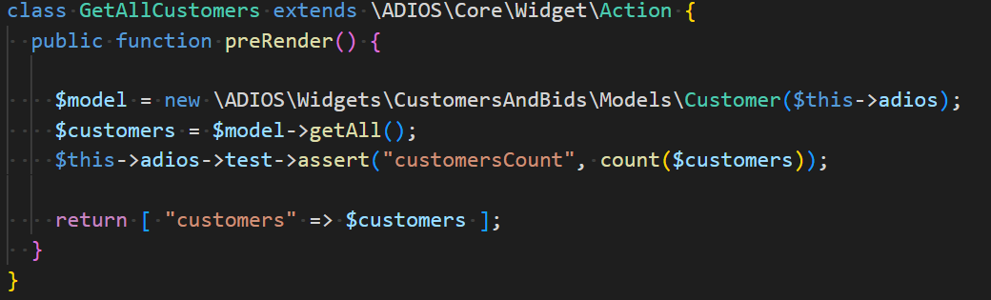
“Testable” code - Example
The actions “tells” the testing engine how much customers are in the database.

Slide 4
Writing tests
New \ADIOS\Core\Test class for supporting the development of tests.
Each test extends this class.
Tests are stored in ROOT_DIR/tests
A ROOT_DIR/test/Runner.php script takes the test name as an argument and runs the test
Test is run using “php Runner.php <TestName>”
Each test must override the init() method
Each test must check assertions using checkAssertions() method

Slide 5
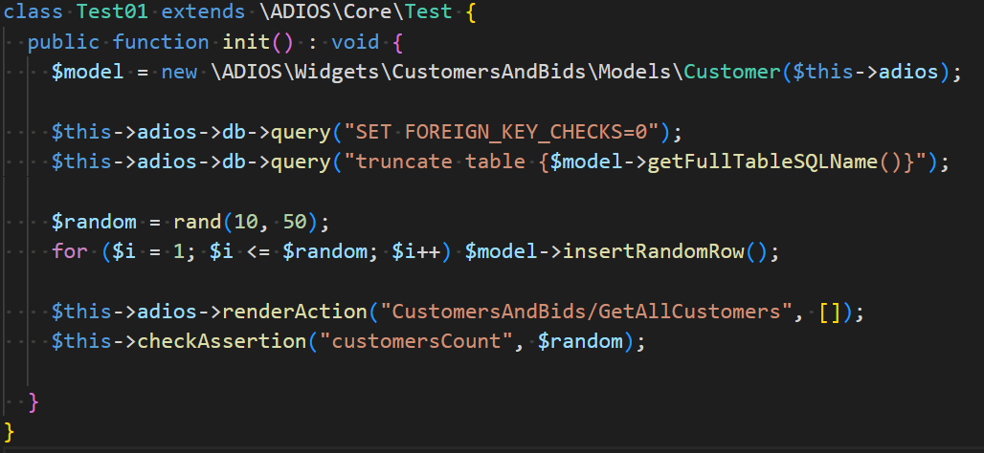
Writing tests - Example
Empty the list of customers and add a random number of customers.
Expect the same number of customers in the database.
Result:

Slide 6
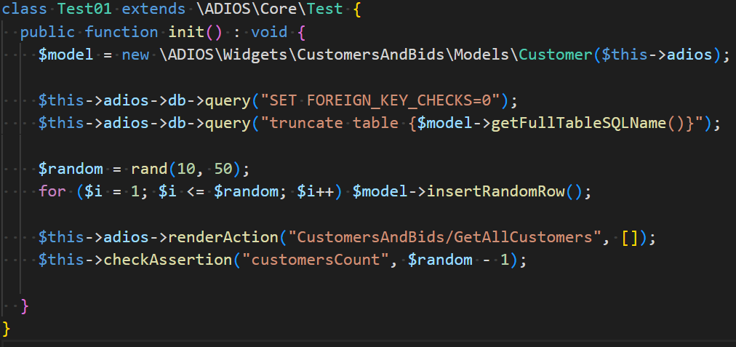
Writing tests – Example – Failed test
Small modification – the test will fail
Result - Failed:

Slide 7
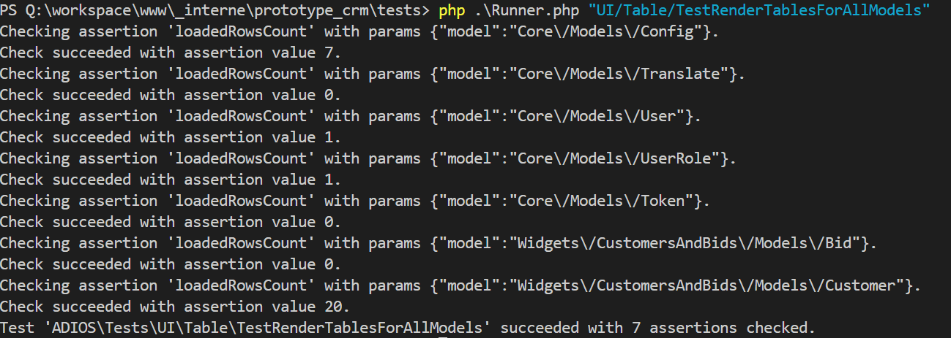
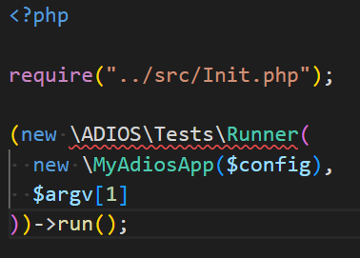
Writing tests – Runner.php
Basic project’s ROOT_DIR/test/Runner.php implementation
Default ADIOS test runner.
Can also run default ADIOS tests.
Output of the default ADIOS test that renders UI/Table for all models.

